Slide 1
Project Presentation of CO-OP
On
SarthiX-RaahSathi
Ashish Yadav (2210991404)
Hitesh Saini (2210991670) Supervised By: Dr. Shikha Tuteja
Department of Computer Science and Engineering,
Chitkara University, Punjab

Slide 2
Introduction
2.1 Background
Lack of structured shipment allocation system
Income instability for drivers
No transparent bidding mechanism
Permit expiration leads to penalties
Limited real-time shipment tracking
2.2 Problem Statement
Develop a digital driver–shipper marketplace
Introduce transparent real-time bidding system
Provide automated permit notifications
Improve compliance and operational efficiency
.
2

Slide 3
Software and Hardware Requirement Specification
3.1 Methods
The development methodology for SarthiX-RaahSathi follows Agile principles, emphasizing iterative progress, flexibility, and continuous user feedback. The project is divided into multiple sprints, with each sprint focusing on the design, development, and testing of specific system modules such as user authentication, bidding management, shipment tracking, and permit notification system. Continuous integration and testing ensure reliability and scalability of the platform.
3.2 Programming/Working Environment
Programming Language: JavaScript (Vite + React for the frontend) Backend & Database: Supabase (PostgreSQL-based backend services) Authentication: Clerk (Secure user authentication & role management) Communication: REST APIs for client-server interaction Architecture: Client-Server Architecture Model
3.3 Requirements to run the application
Operating System: Windows 10 / Linux / MacOS RAM: Minimum 8GB Processor: Intel i5 or equivalent Software Dependencies: Node.js, npm, Supabase configuration, Clerk setup Browser: Latest versions of Chrome, Firefox, or Safari

Slide 4
Keywords
Logistics management system
Driver–Shipper marketplace
Real-time bidding system
Shipment tracking
Permit management
Automated permit notification
Transportation technology
Clerk authentication
Role-based access control
Digital freight platform
Load allocation system.
4

Slide 5
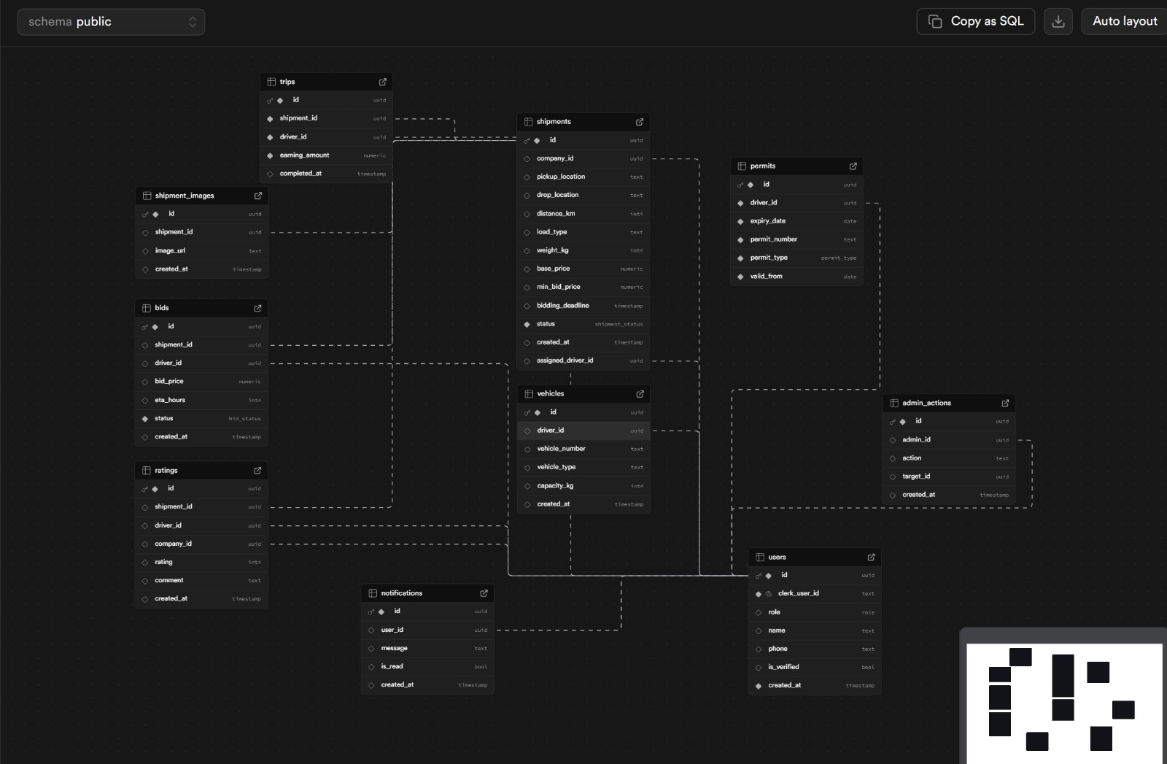
Supabase Overview

Slide 6
TECHNOLOGIES AND TOOLS
SarthiX makes use of a variety of modern tools and technologies to ensure scalability, security, and real-time functionality.
React.js (with Vite):Used for developing a fast, responsive, and dynamic user interface. It enables smooth navigation between dashboards for drivers and shippers.
Supabase:Provides backend services including PostgreSQL database, real-time data handling, and secure data storage for users, bids, shipments, and permit records.
Clerk Authentication:Ensures secure user authentication and role-based access control (Driver / Shipper login management).
REST APIs:Used for efficient communication between frontend and backend services, ensuring secure data exchange.

Slide 7
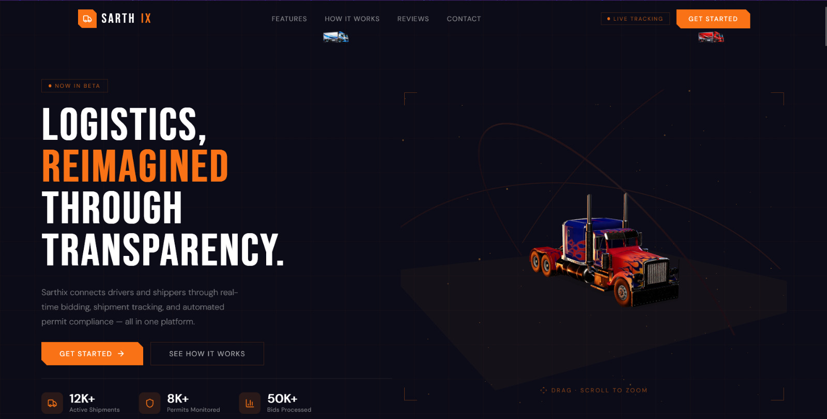
VISUAL REPRESENTATION

Slide 8
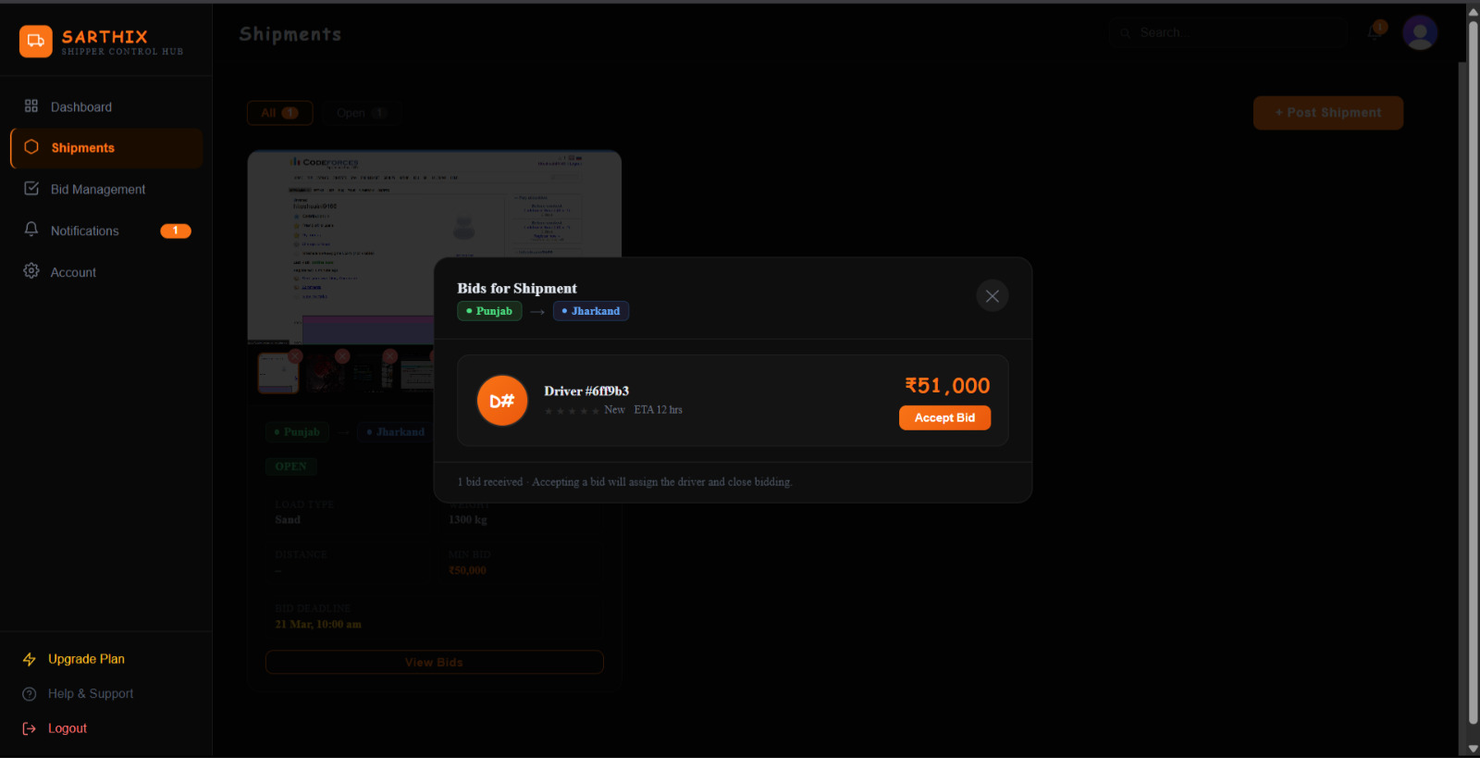
VISUAL REPRESENTATION

Slide 9
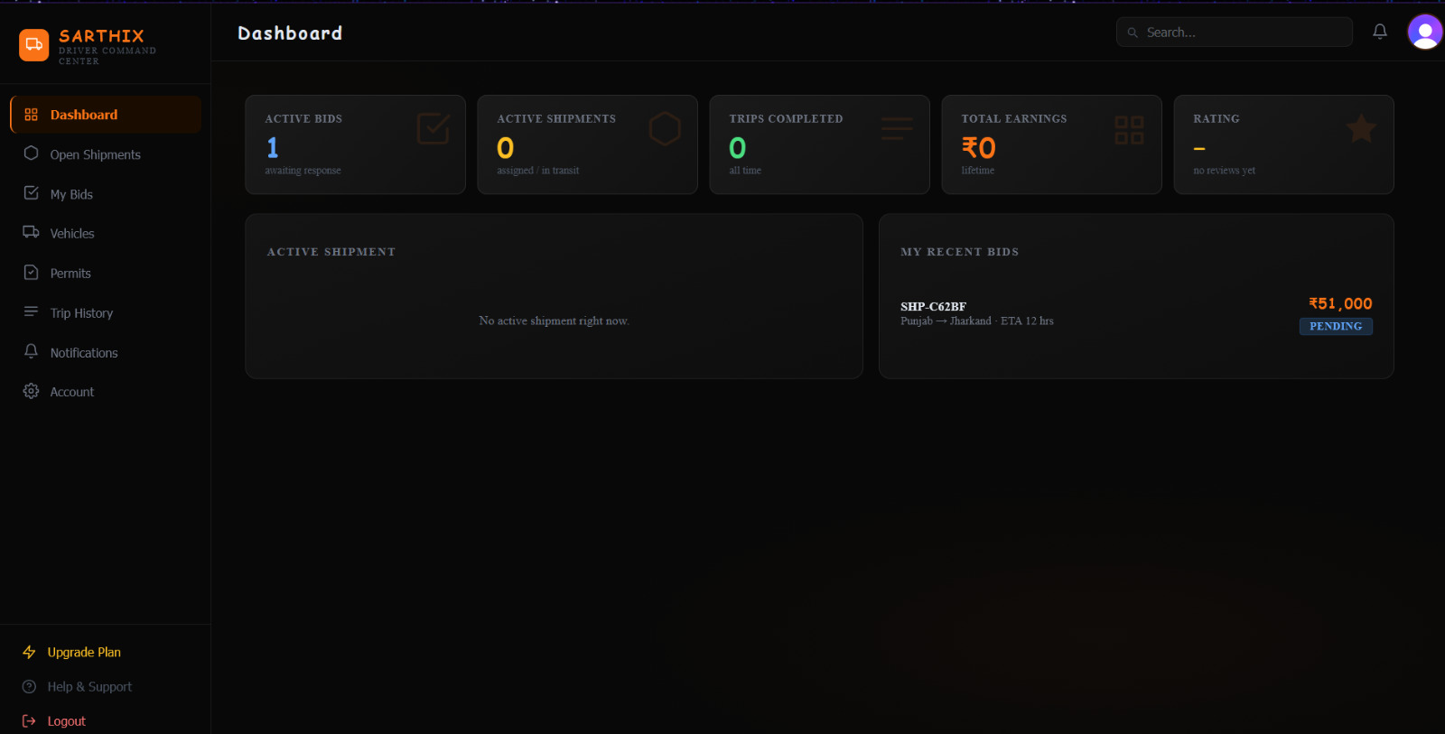
VISUAL REPRESENTATION

Slide 10
Future Scope
The future development of SarthiX holds significant potential for growth and innovation. As logistics technology and digital transportation systems continue to evolve, the platform can be expanded with advanced features to enhance operational efficiency, automation, and transparency. Future improvements may include.
AI-Powered Price Recommendation:Integration of artificial intelligence to suggest optimal bidding prices based on historical shipment data, distance, fuel cost trends, and demand patterns.
Live GPS Tracking Integration:Advanced real-time GPS tracking with route optimization, estimated delivery time prediction, and traffic-based rerouting.
In-App Communication System:Built-in chat and call functionality to enable seamless communication between drivers and shippers without relying on external platforms.
Digital Document Verification:Integration of automated document verification for permits, insurance, and licenses to reduce manual verification delays and enhance compliance.

Slide 11
Conclusion
The development of SarthiX represents a significant advancement in the field of digital logistics and transportation management systems. By combining a real-time bidding mechanism, shipment lifecycle tracking, and automated permit compliance monitoring within a web-based platform, the system effectively bridges the gap between traditional freight allocation methods and modern digital marketplace solutions. It enables drivers and shippers to interact transparently, make informed decisions, and manage shipments efficiently.
Through the integration of technologies such as Vite, React.js, Supabase, and Clerk authentication, SarthiX ensures scalability, performance, security, and reliable role-based access control. The platform not only streamlines load allocation and bidding processes but also reduces compliance risks through automated permit notifications and monitoring features.
In conclusion, SarthiX is more than a logistics marketplace — it is an integrated operational and compliance ecosystem that promotes transparency, efficiency, and trust within the transportation industry. With continuous enhancements and the adoption of emerging technologies, the platform has the potential to evolve into a comprehensive, intelligent, and widely accessible digital freight management solution.

Slide 12
Bibliography/References
React (Official Documentation) Meta. React – A JavaScript Library for Building User Interfaces. https://react.dev
Vite (Official Documentation) Evan You. Vite – Next Generation Frontend Tooling. https://vitejs.dev
Clerk (Authentication Platform) Clerk Inc. Clerk – Authentication and User Management. https://clerk.com/docs
Tailwind CSS (Official Documentation) Tailwind Labs. Tailwind CSS – Utility-First CSS Framework. https://tailwindcss.com/docs
Supabase (Official Documentation) Supabase Inc. Supabase – Open Source Firebase Alternative. https://supabase.com/docs
Supabase Storage (Bucket Service) Supabase Inc. Supabase Storage – File & Object Storage. https://supabase.com/docs/guides/storage
Express.js (Official Documentation) OpenJS Foundation. Express – Fast, Unopinionated Web Framework for Node.js. https://expressjs.com
PostgreSQL (Official Documentation) PostgreSQL Global Development Group. PostgreSQL – Advanced Open Source Relational Database. https://www.postgresql.org/docs

Slide 13
Thank You
13

